Slide 1



UNIT 1
LESSON 2
MONEY MATTERS
Part 3

Slide 2
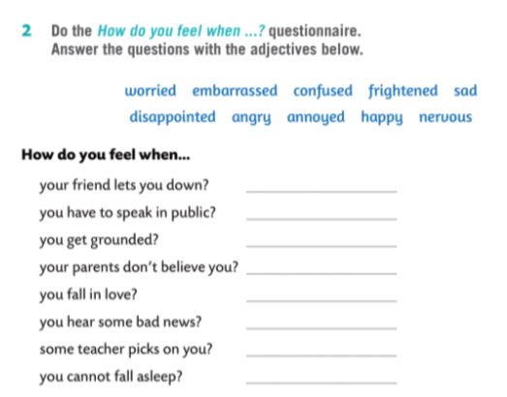

Slide 3
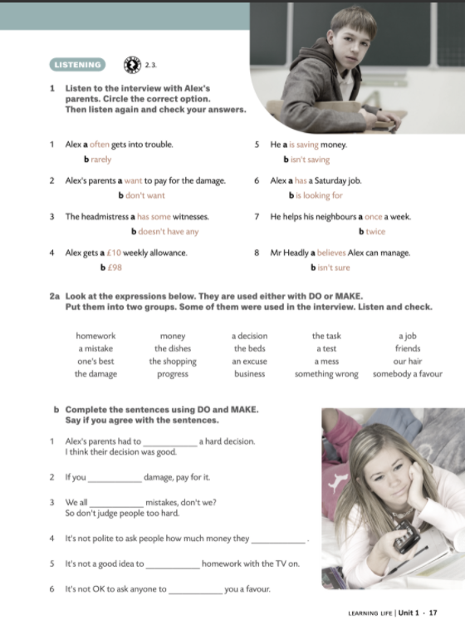


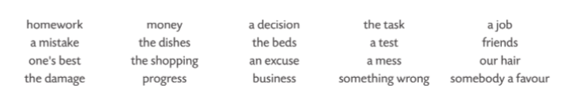
DO: homework, one’s best, the damage, the dishes, the shopping, business, the task, a test, something wrong, a job, your hair, somebody a favour
MAKE: a mistake, money, progress, a decision, the beds, an excuse, a mess, friends

Slide 4

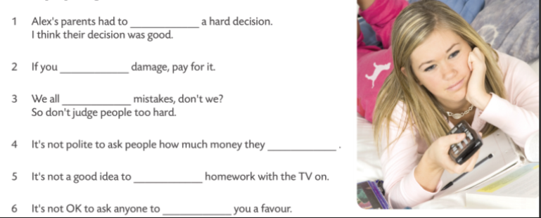

make
do
make
make
do
DO or MAKE
do

Slide 5
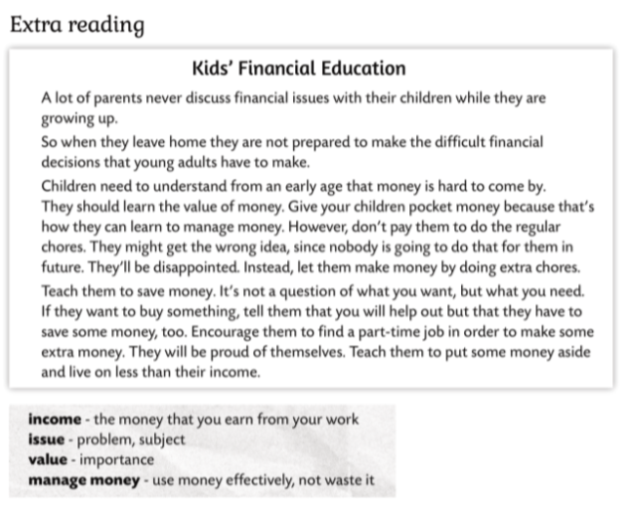
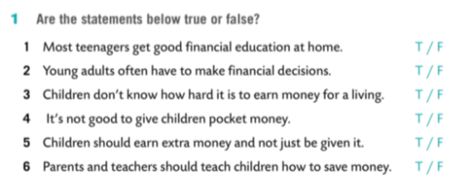

Slide 6
